Slide 1
Queue
1

Slide 2

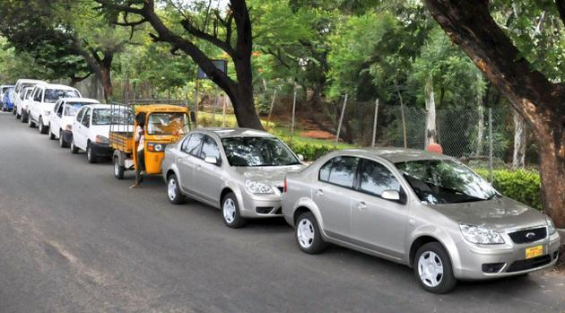
What’s this ?
Anna University, Chennai - 600 025

Slide 3
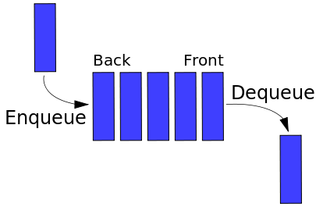
Queue

Slide 4
Queue
A stack is LIFO (Last-In First Out) structure. In contrast, a queue is a FIFO (First-In First-Out ) structure.
In a FIFO data structure, the first element added to the queue will be the first one to be removed.
A queue is a linear structure for which items can be only inserted at one end and removed at another end.
Anna University, Chennai - 600 025

Slide 5
Operations on Queue
We will dedicate once again six operations on the Queue.
  You can add a person to the queue (enque),
  Look who is the first person to be serviced (front)
  Rremove the first person (dequeue) and
  Check whether the queue is empty (isEmpty).
  Also there are two more operations to create and to destroy the queue.
Anna University, Chennai - 600 025

Slide 6
Operations
Queue create()
  Creates an empty queue
boolean isEmpty(Queue q)
  Tells whether the queue q is empty
enqueue(Queue q, Item e)
  Place e at the rear of the queue q
destroy(Queue q)
  destroys queue q
Anna University, Chennai - 600 025

Slide 7
Operations Continued
Item front(Queue q)
  returns the front element in Queue q without removing it
  Precondition: q is not empty
dequeue(Queue q)
  removes front element from the queue q
  Precondition: q is not empty
Anna University, Chennai - 600 025

Slide 8
Implementation Using Arrays
If we use an array to hold queue elements, dequeue operation at the front (start) of the array is expensive.
This is because we may have to shift up to “n” elements.
For the stack, we needed only one end; for queue we need both.
To get around this, we will not shift upon removal of an element.
Anna University, Chennai - 600 025

Slide 9
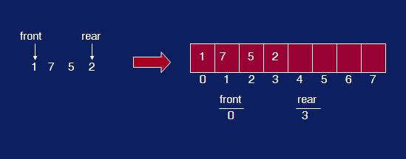
Snapshot of a Queue
Anna University, Chennai - 600 025

Slide 10
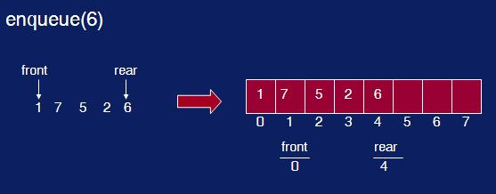
enqueue()
Anna University, Chennai - 600 025

Slide 11
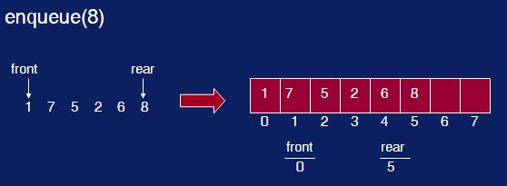
enqueue() again
Anna University, Chennai - 600 025

Slide 12
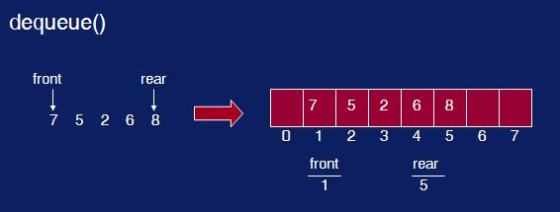
dequeue()
Anna University, Chennai - 600 025

Slide 13
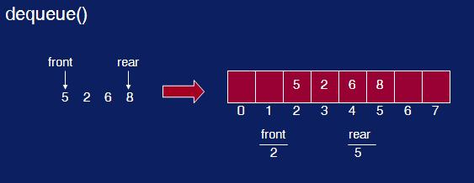
dequeue() again
Anna University, Chennai - 600 025

Slide 14
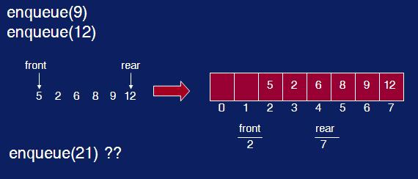
Two more enqueue()
Anna University, Chennai - 600 025

Slide 15
What’s Wrong ?
We have inserts and removal running in constant time but we created a new problem.
We cannot insert new elements even though there are two places available at the start of the array.
Solution: allow the queue to “wrap around”. Basic idea is to picture the array as a circular array as show below.
Anna University, Chennai - 600 025

Slide 16
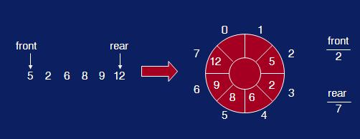
Queue array wrap-around
Anna University, Chennai - 600 025

Slide 17
enqueue(element)
void enqueue(int x)
{
rear = (rear+1)%size;
array[rear] = x;
noElements = noElements+1;
}
Anna University, Chennai - 600 025

Slide 18
dequeue()
int dequeue()
{
int x = array[front];
front = (front+1)%size;
noElements = noElements-1;
return x;
}
Anna University, Chennai - 600 025

Slide 19
isEmpty() and isFull()
int isFull()
{
return noElements == size;
}
int isEmpty()
{
return noElements == 0;
}
Anna University, Chennai - 600 025

Slide 20
Pointer Based Implementation
Possible implementations of a pointer-based queue
  A linear linked list with two external references
    A reference to the front
    A reference to the back
  A circular linked list with one external reference
    A reference to the back
Anna University, Chennai - 600 025

Slide 21
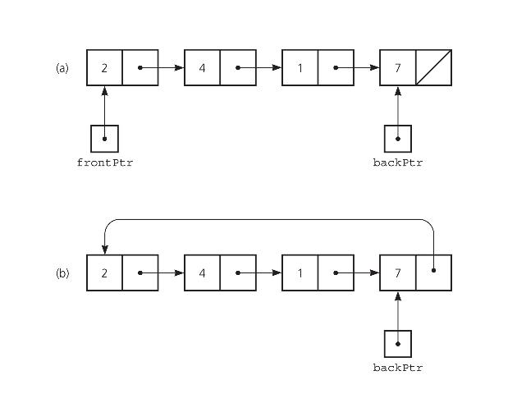
Queue - Linear and Circular List
Anna University, Chennai - 600 025

Slide 22
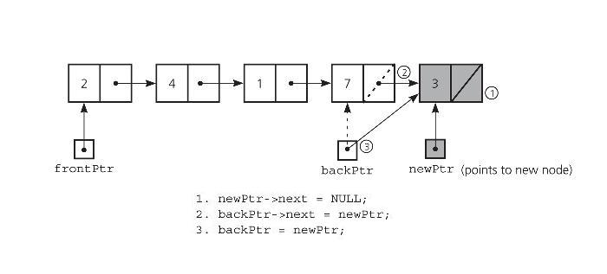
Non-empty Queue - Insertion
Anna University, Chennai - 600 025

Slide 23
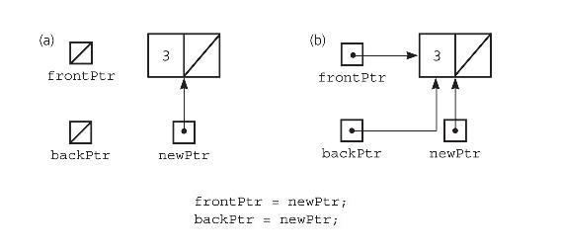
Empty Queue - Insertion
Anna University, Chennai - 600 025

Slide 24
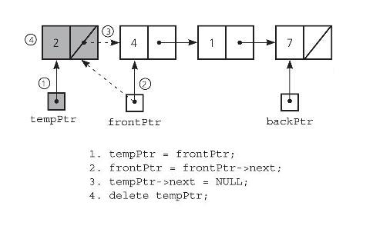
Queue with more than 1 element - Deletion
Anna University, Chennai - 600 025

Slide 25
Applications of Queues
Queue is used when things don’t have to be processed immediatly, but have to be processed in First In First Out order like Breadth First Search.
This property of Queue makes it also useful in following kind of scenarios.
Anna University, Chennai - 600 025

Slide 26
Applications of Queues
When a resource is shared among multiple consumers. Examples include CPU scheduling, Disk Scheduling.
When data is transferred asynchronously (data not necessarily received at same rate as sent) between two processes. Examples include IO Buffers, pipes, file IO, etc.
Operating systems often maintain a queue of processes that are ready to execute or that are waiting for a particular event to occur.
Anna University, Chennai - 600 025

Slide 27
Applications of Queues
Computer systems must often provide a “holding area” for messages between two processes, two programs, or even two systems. This holding area is usually called a “buffer” and is often implemented as a queue.
Call center phone systems will use a queue to hold people in line until a service representative is free.
Anna University, Chennai - 600 025

Slide 28
Applications of Queues
Buffers on MP3 players and portable CD players, iPod playlist. Playlist for jukebox - add songs to the end, play from the front of the list.
Round Robin (RR) algorithm is an important scheduling algorithm. It is used especially for the time-sharing system. The circular queue is used to implement such algorithms.
Anna University, Chennai - 600 025

Slide 29
Why Doubly Linked List ?
given only the pointer location, we cannot access its predecessor in the list.
Another task that is difficult to perform on a linear linked list is traversing the list in reverse.
Doubly linked list A linked list in which each node is linked to both its successor and its predecessor
In such a case, where we need to access the node that precedes a given node, a doubly linked list is useful.
Anna University, Chennai - 600 025

Slide 30
Doubly Linked List
In a doubly linked list, the nodes are linked in both directions. Each node of a doubly linked list contains three parts:
  Info: the data stored in the node
  Next: the pointer to the following node
  Back: the pointer to the preceding node
Anna University, Chennai - 600 025

Slide 31
Operations on Doubly Linked Lists
The algorithms for the insertion and deletion operations on a doubly linked list are somewhat more complicated than the corresponding operations on a singly linked list.
The reason is clear: There are more pointers to keep track of in a doubly linked list.
Anna University, Chennai - 600 025

Slide 32
Inserting Item
As an example, consider the Inserting an item.
To link the new node, after a given node, in a singly linked list, we need to change two pointers:
  newNode->next and
  location->next.
The same operation on a doubly linked list requires four pointer changes.
Anna University, Chennai - 600 025

Slide 33
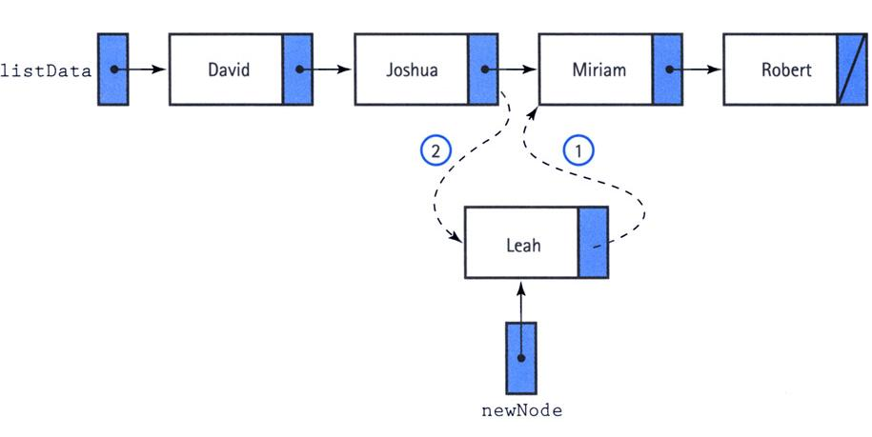
Singly Linked List Insertion
Anna University, Chennai - 600 025

Slide 34
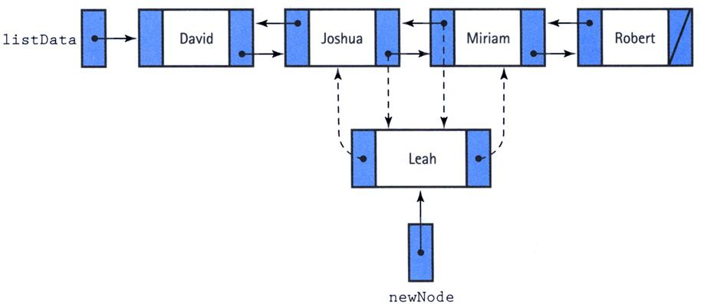
Doubly Linked List Insertion
Anna University, Chennai - 600 025

Slide 35
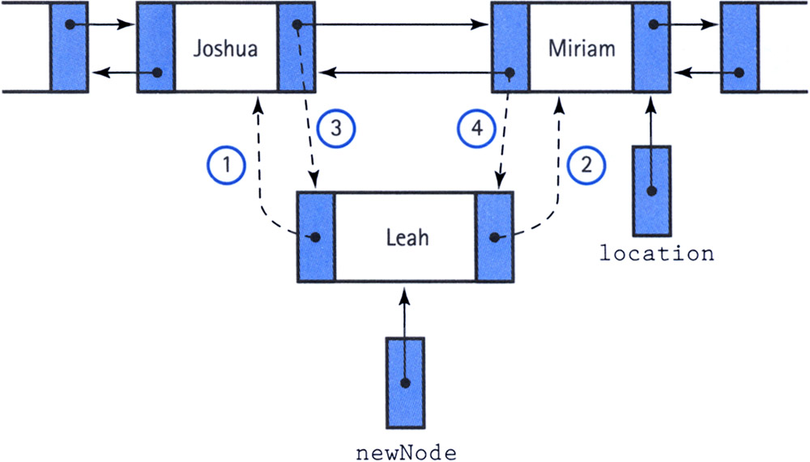
The Order is Important
Anna University, Chennai - 600 025

Slide 36
Doubly Linked List - Deletion
One useful feature of a doubly linked list is its elimination of the need for a pointer to a node's predecessor to delete the node.
Through the back member, we can alter the next member of the preceding node to make it jump over the unwanted node.
Then we make the back pointer of the succeeding node point to the preceding node.
Anna University, Chennai - 600 025

Slide 37
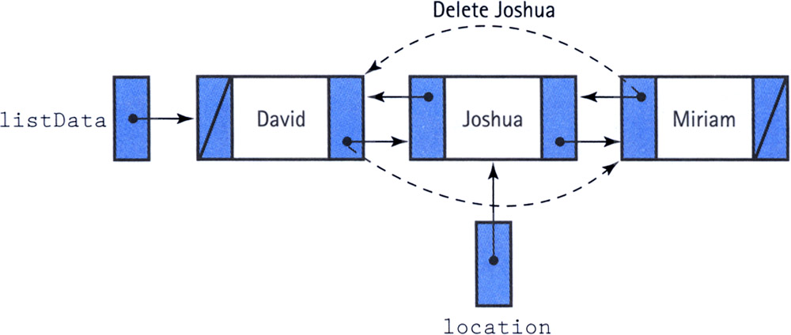
Doubly Linked List - Deletion
Anna University, Chennai - 600 025

Slide 38
Special Cases of Deletion
We do, however, have to be careful about the end cases:
  If location->back is NULL, we are deleting the first node
  if location->next is NULL, we are deleting the last node.
  If both location->back and location->next are NULL, we are deleting the only node.
Anna University, Chennai - 600 025

Slide 39

Interaction
Anna University, Chennai - 600 025

